Slide 1


Conflict-Free Genetic Algorithm with Nash Equilibrium Seeking for Game-based Battery Swapping Station Recommendation
Chang-Long Sun, Xin-Xin Xu (Co-First Author), Chun-Hua Chen* (Corresponding Author), Member, IEEE, Jun Hong, Sam Kwong, Fellow, IEEE, and Zhi-Hui Zhan** (Corresponding Author), Fellow, IEEE
Presenter: Jian-Yu Li
2024/10/7
Notes:
Hello everyone, it's a pleasure to share our paper with you. The topic of this sharing is: Conflict-Free Genetic Algorithm with Nash Equilibrium Seeking for Game-based Battery Swapping Station Recommendation

Slide 2
Outline
01
Introduction
02
Background
03
Algorithm
04
Experiment
05
Future plans
Notes:
This sharing is divided into 5 parts as shown in above.

Slide 3
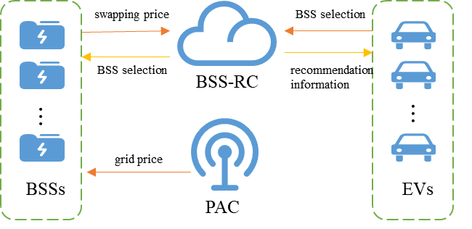
Introduction
Background
Algorithm
Experiment
Future plans
BSS recommendation problem
The Battery Swapping Station (BSS) recommendation problem [1] is a key research area, focusing on recommending the most suitable BSS for Electric Vehicles (EVs) to maximize the utilization of BSS or minimize the cost of EVs.
However, the lowest total cost is not necessarily the most appropriate allocation for each EV.
Figure 1. BSS recommendation system model.
[1]N. I. Nimalsiri, C. P. Mediwaththe, E. L. Ratnam, M. Shaw, D. B. Smith, and S. K. Halgamuge, “A survey of algorithms for distributed charging control of electric vehicles in smart grid,” IEEE Trans. Intell. Transp. Syst., vol. 21, no. 11, pp. 4497–4515, Nov. 2019.
3
Notes:
Electric vehicles (EVs) are increasingly recognized as a sustainable transportation solution for the global energy crisis and environmental pollution. Battery swapping, where customers exchange depleted batteries for charged ones at a battery swapping station (BSS) in minutes, is a promising solution. It prevents issues associated with simultaneous EV charging and extends battery life offering benefits for power system operations.
The BSS recommendation problem is a key research topic, focusing on recommending the most suitable BSS for EVs to maximize BSS utilization or minimize the cost of EVs. However, the lowest total cost is not necessarily the most appropriate allocation for each EV. Consider such a scenario: although a BSS allocation has been recommended with the lowest total cost for all the EVs, there might be a BSS with a lower cost available for a particular EV. Then this EV would naturally change its strategy to choose the BSS with the lowest cost. This change could lead to increased costs for other EVs, prompting them to adjust their choices as well, potentially making the recommended plan unstable. Therefore, the BSS recommendation problem can not only be modeled as a combinatorial optimization problem with the objective of minimizing the total cost, but also be modeled as a non-cooperative game problem.

Slide 4
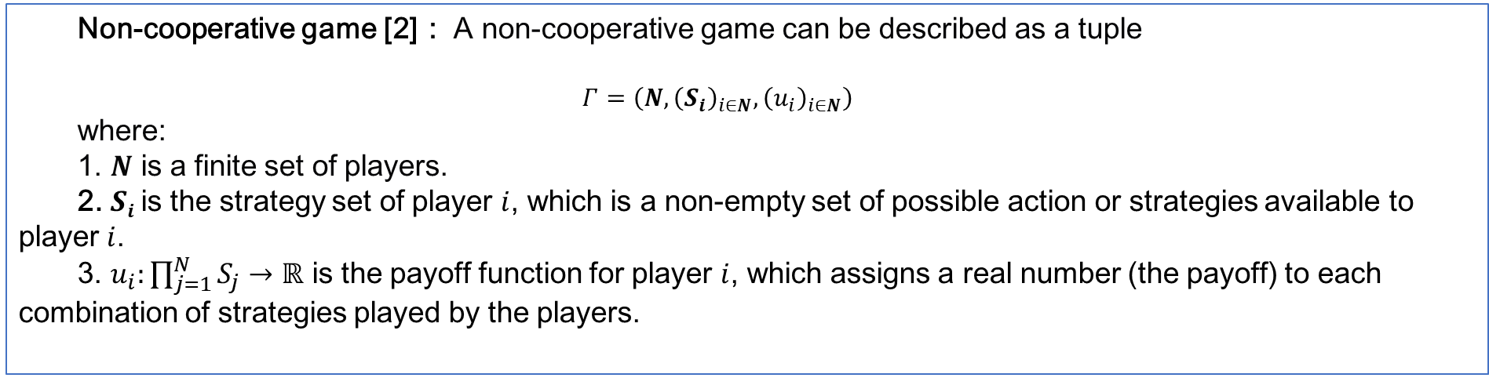
Introduction
Background
Algorithm
Experiment
Future plans
Non-cooperative game [2]： A non-cooperative game can be described as a tuple
$$Γ=\left(N,{\left(S_{i}\right)}_{i∈N},{\left(u_{i}\right)}_{i∈N}\right)$$
where:
1. $N$ is a finite set of players.
2. $Si$is the strategy set of player $i$, which is a non-empty set of possible action or strategies available to player $i$.
3. $u_{i}:\prod_{j=1}^{N}{S_{j}}→ℝ$ is the payoff function for player $i$, which assigns a real number (the payoff) to each combination of strategies played by the players.
[2] Nash J. Non-Cooperative Games. The Annals of Mathematics. 1951;54.
4
4
Notes:
A non-cooperative game refers to a type of game where participants independently choose strategies to maximize their own interests without collaboration.
Speak according to the above formula

Slide 5
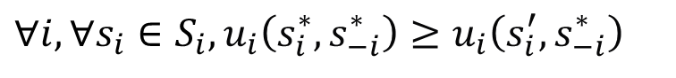
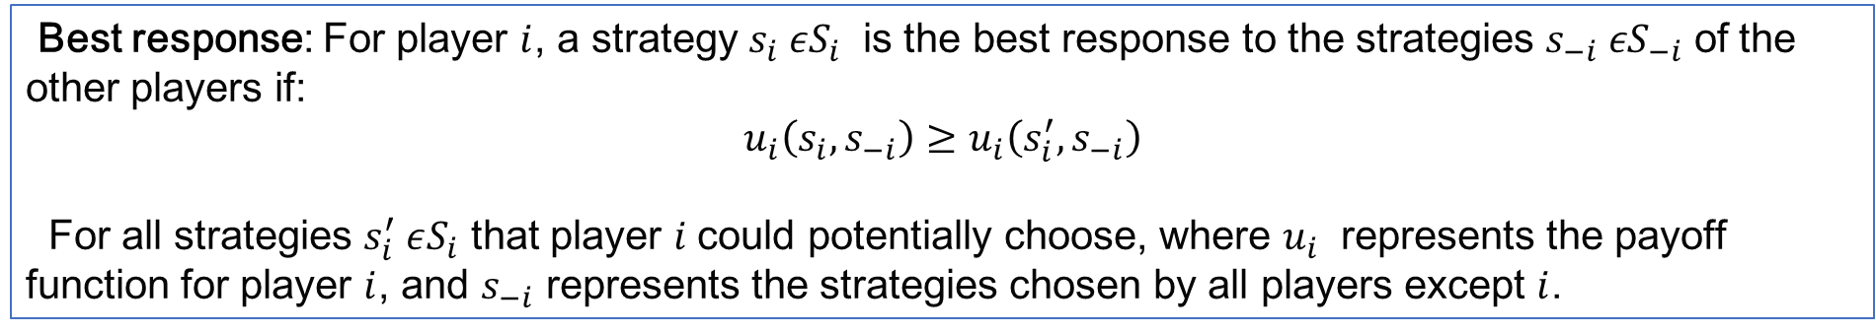
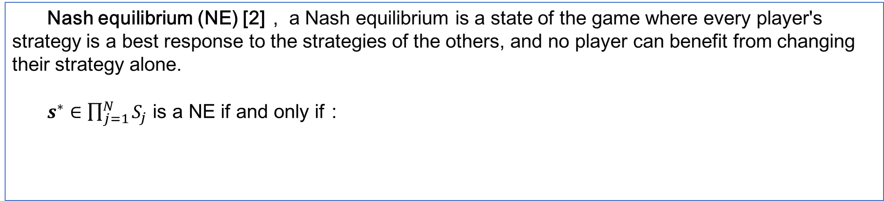
Introduction
Background
Algorithm
Experiment
Future plans
Best response: For player $i$, a strategy $s_{i} εS_{i}$​ is the best response to the strategies $s_{−i} εS_{−i}$ of the other players if:
$$u_{i}\left(s_{i},s_{−i}\right)≥u_{i}\left(s_{i}^{′},s_{−i}\right)$$
For all strategies $s_{i}^{′} εS_{i}$​ that player $i$could potentially choose, where $u_{i}$​ represents the payoff function for player $i$, and $s_{−i}$ represents the strategies chosen by all players except $i$.
Nash equilibrium (NE) [2]， a Nash equilibrium is a state of the game where every player's strategy is a best response to the strategies of the others, and no player can benefit from changing their strategy alone.
$s^{∗}∈\prod_{j=1}^{N}{S_{j}}$ is a NE if and only if：
$$∀i,∀s_{i}∈S_{i},u_{i}\left(s_{i}^{∗},s_{−i}^{∗}\right)≥u_{i}\left(s_{i}^{′},s_{−i}^{∗}\right)$$
[2] Nash J. Non-Cooperative Games. The Annals of Mathematics. 1951;54.
5
Notes:
Non-cooperative games incorporate two important concepts. Speak according to the above formulas

Slide 6
Introduction
Background
Algorithm
Experiment
Future plans
Case 1: Lowest total cost
Table 2. Driving cost
BSS number EV number | 1 | 2
1 | 6 | 18
2 | 7 | 16
3 | 8 | 11
4 | 19 | 8
1
2
Table 1. Battery swapping price
The number of EV | cost
1 | 6
2 | 8
3 | 10
4 | 12
1
2
3
4
Table 3. EV Cost(Total cost=64)
Figure 2. EV selection strategy
BSS number EV number | 1 | 2
1 | 6+8=14 | 18
2 | 7+8=15 | 16
3 | 8 | 11+8=19
4 | 19 | 8+8=16
BSS
EV
6
Notes:
Here is an example comparing the optimal total cost solution with the Nash Equilibrium. As shown in Table 1, the more EVs included in the BSS, the higher the battery swapping price. In the right figure, BSS 1 and BSS 2 are each selected by 2 EVs, hence the swapping price for both BSSs is set at 8. Table 2 illustrates the cost for EVs to travel to the BSS. Table 3 provides the sum of battery swapping cost and travel cost for each EV. It can be verified that the solution shown in the figure 2 has the minimum total cost, which is optimal.

Slide 7
Introduction
Background
Algorithm
Experiment
Future plans
Case 2: Nash equilibrium
Table 2. Driving cost
BSS number EV number | 1 | 2
1 | 6 | 18
2 | 7 | 16
3 | 8 | 11
4 | 19 | 8
1
2
Table 1. Battery swapping price
The number of EV | cost
1 | 6
2 | 8
3 | 10
4 | 12
1
2
3
4
Table 4. EV Cost(Total cost=65)
Figure 3. EV selection strategy
BSS number EV number | 1 | 2
1 | 6+10=16 | 18
2 | 7+10=17 | 16
3 | 8+10=18 | 11
4 | 19 | 8+6=14
BSS
EV
7
Notes:
However, for EV 3, choosing BSS 1 instead of BSS 2 can reduce its own cost, that is, the cost is reduced from 19 to 18, as shown in Table 4. Nevertheless, due to the increased number of EVs in BSS 1, the exchange price for BSS 1 goes up, leading to an increase in the total cost. In addition, no EV can reduce its own cost by changing its own strategy, that is, the solution shown in Figure 3 is a Nash equilibrium.

Slide 8
Introduction
Background
Algorithm
Experiment
Future plans
Optimal Nash equilibrium (ONE)
Optimization problem
optimal Nash equilibrium (ONE)
Non-cooperative game
objective：
optimal solution
objective ：
Nash equilibrium
Algorithm: CFGA
Algorithm: NES
8
Notes:
To integrate the advantages of the optimization-based methods and game-based methods, we proposes modeling the BSS recommendation problem as a non-cooperative optimization problem (NCOP) and the goal of NCOP is to find an optimal Nash equilibrium (ONE) solution. Note that in a non-cooperative game problem, there may be multiple NE solutions. However, in our NCOP, the goal of ONE is to find the optimal one (e.g., the lowest total cost one). To find the ONE, we firstly propose a novel conflict-free genetic algorithm (CFGA) to find an optimal solution to the NCOP. Then, the resulting optimal solution is used as initial strategy for a Nash equilibrium seeking (NES) approach , which will iteratively converge to the ONE. This way, the integrated CFGA-NES algorithm can find the ONE to the BSS recommendation problem.

Slide 9
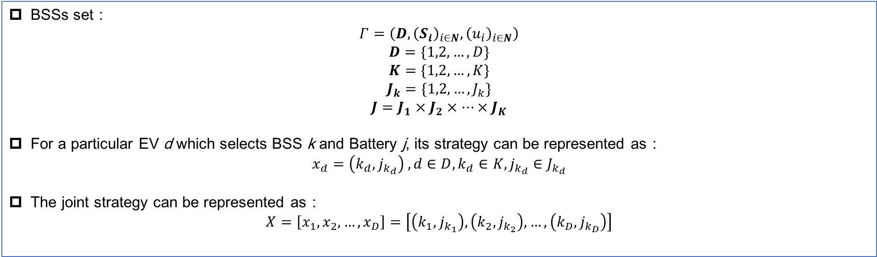
Introduction
Background
Algorithm
Experiment
Future plans
Model
BSSs set：
$$Γ=\left(D,{\left(S_{i}\right)}_{i∈N},{\left(u_{i}\right)}_{i∈N}\right)$$
$$D=\{1,2,…,D\}$$
$$K=\{1,2,…,K\}$$
$$J_{k}=\{1,2,…,J_{k}\}$$
$$J=J_{1}×J_{2}×…×J_{K}$$
For a particular EV d which selects BSS k and Battery j, its strategy can be represented as：
$$x_{d}=\left(k_{d},j_{k_{d}}\right) , d∈D,k_{d}∈K,j_{k_{d}}∈J_{k_{d}}$$
The joint strategy can be represented as：
$$X=\left[x_{1},x_{2},…,x_{D}\right]=\left[\left(k_{1},j_{k_{1}}\right),\left(k_{2},j_{k_{2}}\right),…,\left(k_{D},j_{k_{D}}\right)\right]$$
9
Notes:
Assuming there are D EVs within a certain area and K BSSs, for a certain BSS k, it contains J_{k} batteries. A tuple vector $X$ of size 2×D is used to represent the joint strategy of each EV choosing a BSS and a battery . Here the $k_{1}$ is the BSS number and $j_{k_{1}}$ is the BSS number selected by EV 1.

Slide 10

Introduction
Background
Algorithm
Experiment
Future plans
Constraint
Conflict-free Constraint:
$$∀d_{1},d_{2}ε\left[1,D\right], d_{1}≠d_{2}⟺\left(k_{d_{1}},j_{k_{d_{1}}}\right)≠\left(k_{d_{2}},j_{k_{d_{2}}}\right) (1)$$
Remaining Battery Charge Constraint:
$$∆E_{c}=av^{2}+bv+c (2)$$
$$E_{d,k}^{cost}=s_{d,k}∆E_{c} (3)$$
$$E_{d,k}^{res}=E_{d}^{init}−E_{d,k}^{cost} (4)$$
$$E_{d,k}^{res}≥{\hat{E}}_{d} (5)$$
Sufficient Battery Charge Constraint：
$$\tilde{E_{d,k}^{j}}≥E_{d}^{thr} (6)$$
10
Notes:
During the selection process of each EV towards BSSs, a series of constraints must be met. The constraints that need to be satisfied are as follows:
1）Conflict-free Constraint
Different EVs can only choose different batteries at the same moment.
2）Remaining Battery Charge Constraint
When an EV arrives at the BSS, it is required to retain a certain amount of battery charge.
3) Sufficient Battery Charge Constraint
A certain amount of battery chargeshould be reserved after the EV undergoes a battery swapping.

Slide 11
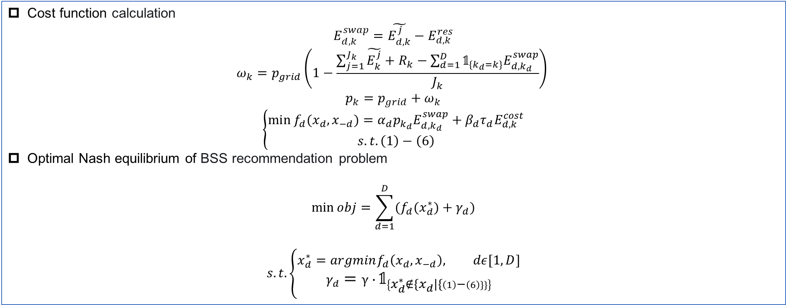
Introduction
Background
Algorithm
Experiment
Future plans
Swapping price calculation
Cost function calculation
$$E_{d,k}^{swap}=\tilde{E_{d,k}^{j}}−E_{d,k}^{res}$$
$$ω_{k}=p_{grid}\left(1−\frac{\sum_{j=1}^{J_{k}}{\tilde{E_{k}^{j}}}+R_{k}−\sum_{d=1}^{D}{𝟙_{{\{k}_{d}=k\}}E_{d,k_{d}}^{swap}}}{J_{k}}\right)$$
$$p_{k}=p_{grid}+ω_{k}$$
$$\left\{\begin{aligned}\min{f_{d}(x_{d},x_{−d})={α_{d}p_{k_{d}}E}_{d,k_{d}}^{swap}+β_{d}{τ_{d}E}_{d,k}^{cost}} \\ s.t.\left(1\right)−\left(6\right)\end{aligned}\right.$$
Optimal Nash equilibrium of BSS recommendation problem
$$\min{obj=\sum_{d=1}^{D}{(f_{d}(x_{d}^{∗})+γ_{d})}}$$
$$s.t.\left\{\begin{aligned}x_{d}^{∗}=argminf_{d}\left(x_{d},x_{−d}\right), dε[1,D] \\ γ_{d}=γ∙𝟙_{\left\{x_{d}^{∗}∉\{x_{d}|\{\left(1\right)−\left(6\right)\}\}\right\}}\end{aligned}\right.$$
11
Notes:
The cost function of each EV d is the weighted average of the power change cost and the distance cost. As the above formula shows, $E_{d,k}^{swap}$ represents the amount of electricity swapped between EV d and BSS k, R_{k} represents the sum of newly added charging energy of all batteries, $E_{d,k}^{cost}$ represents the traveling cost between EV d and BSS k, p_{grid} represents the grid price and $ω_{k}$ represents the service price.
If the BSS recommendation problem is modeled as a NC-OP, the objective is to minimize the total cost of EV while ensuring that the solution is a Nash equilibrium.

Slide 12
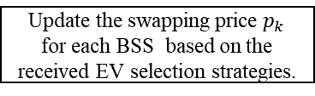
Introduction
Background
Algorithm
Experiment
Future plans
Two stage flowchart of CFGA-NES
CFGA
NES [3]
start
Initial the input of NES wih the optimal strategy obtained by CFGA
Random initialize the population
Update the swapping price $p_{k}$ for each BSS based on the received EV selection strategies.
Calculate candidate set
for each EV d, calculate the cost to all BSSs based on the swapping price of BSS k and its distance to k, and select the BSS with the minimum cost to update its own strategy until all EVs have updated their strategies.
Elitism selection
Update the population by OX and REM operator
Meet the termination condition?
Meet the termination condition
Save the final EV strategy and cost
Save the final EV strategy and cost
end
12
[3]L. Ran, Y. Wan, J. Qin, W. Fu, D. Zhang and Y. Kang, “A game-based battery swapping station recommendation approach for electric vehicles,” IEEE Trans. Intell. Transp. Syst., vol. 24, no. 9, pp. 9849 - 9860, Sep. 2023.
12
Notes:
The algorithm CFGA-NES for solving the BSS recommendation problem consists of two stages. In the first stage, CFGA algorithm is used to solve the lowest total cost solution, and in the second stage, NES is used. The lowest total cost solution obtained in the first stage is iterated as the initial solution, and the Nash equilibrium solution with the lowest total cost solution is obtained.
The flowchart for CFGA is shown above
1. Random initialize the population
2. Use the elitism strategy to choose operation keep population top ${size}_{elite}$ individuals.
3. Use the OX operator to meet Conflict-free requirements and retain certain sequence information of the parent.
4. The REM operator is adopted for variation, which satisfies Conflict-free and makes it possible for variation to come from both internal and external sources.
5. Run CFGA until the termination condition is met.
6. Save the final EV strategy as the optimal solution
The flowchart for NES is shown above
1. Initial the input of NES wih the optimal strategy obtained by CFGA.
2. Update the swapping price for each BSS based on the received EV selection strategies.
3. Update the EV selection strategies based on swapping price.
4. Run NES until the termination condition is met.
5. Save the final EV strategy as the minimum total cost Nash equilibrium, i.e., the ONE

Slide 13
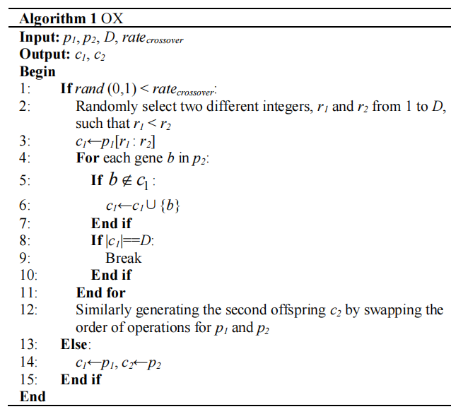
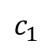
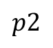
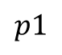
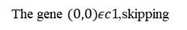
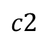
Introduction
Background
Algorithm
Experiment
Future plans
Order crossover (OX) operator
Randomly selected
slice c1 from p1
$$p1$$
(0,1) | (1,0) | (0,0) | (1,2) | (2,0) | (2,1)
$$p2$$
(2,2) | (2,0) | (1,2) | (1,1) | (0,1) | (0,0)
③
④
①
②
The gene $(0,0)εc1$,skipping
$$c_{1}$$
(2,0) | (1,0) | (0,0) | (1,1) | (0,1) | (2,2)
$$c2$$
(0,0) | (2,0) | (1,2) | (2,1) | (0,1) | (1,0)
Figure 4. Order crossover(OX) operator
13
Notes:
The goal of the OX operator is to preserve the order information of the parent chromosomes while generating new offspring chromosomes. Besides, the OX operator ensures that each gene in a chromosome appears only once, preventing duplicate genes within a single chromosome through this crossover strategy. The details of the OX algorithm are presented in Algorithm 2, and the procedures of OX are illustrated as follows.
Step 1: Choose Crossover Points. Randomly select two crossover points on each of the two parent chromosomes. These points define the region for crossover.
Step 2: Copy Genes. Copy the gene sequence from the first parent chromosome between the two crossover points.
Step 3: Fill Genes. On the second parent chromosome, start filling in the remaining genes from the second crossover point onwards in order. Filling must ensure that already filled genes are not repeated and that the relative order of genes is maintained.
Step 4: Generate Offspring. After completing the above steps, a new offspring chromosome are obtained. These offspring chromosomes combine the genetic information of both parents while maintaining the relative order of genes.
Take the picture above for example. Firstly, select index 1,3 as the crossover points. Then, copy the gene slice from p1 between index 1,3 as a part of offspring . The gene slice from p1 is marked with yellow. Next, filling in the remaining genes from the 3_{rd} dimensions in onwards in order to .The filling order is marked with number. Note that the gene (0,0) repeats with , so this gene would be skipped. Filling c1 with genes until its length reaches D, and the offspring c2 is generated similarly.

Slide 14
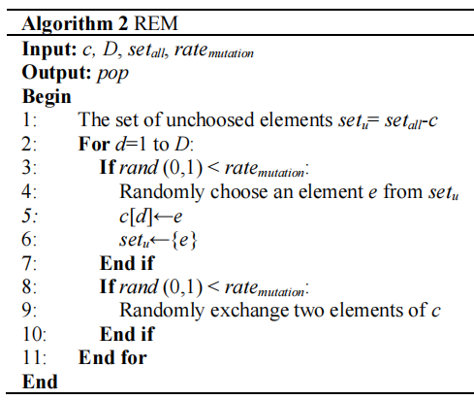
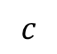
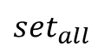
Introduction
Background
Algorithm
Experiment
Future plans
Replace and exchange mutation (REM) operator
$${set}_{all}$$
(0,0) | (0,1) | (0,2) | (1,0) | (1,1) | (1,2) | (1,3) | (2,0) | (2,1) | (2,2)
replacement
Randomly replace a legal gene from the set of all candidate elements
$$c$$
(0,1) | (1,0) | (0,0) | (1,2) | (2,0) | (2,1)
exchange
Randomly exchange two genes
(0,1) | (0,2) | (0,0) | (1,2) | (2,0) | (2,1)
Get the result of REM
(1,2) | (0,2) | (0,0) | (0,1) | (2,0) | (2,1)
Figure 5. Replace and exchange mutation(REM) operator
14
Notes:
Similar to OX operator，the REM operator can also ensure that each gene in a chromosome appears only once. The REM operator performs external replacement and internal exchange operations on genes within the chromosome, which increasing the diversity of mutations. The details of the REM algorithm are presented in Algorithm 2, and the procedures of REM are illustrated as follows.
Step 1: Get the set of elements that do not duplicate c by doing the difference between the set of all candidate elements and c.
Step 2: Randomly select a gene from to replace a gene of c with a small probability.
Step 3: Randomly exchange two gene with a small probability.
Step 4: After completing the above steps, a new mutated chromosome is obtained. The mutated chromosome increases the population diversity and reduces the possibility of the algorithm falling into local optimal.
Take the picture above for example., given chromosome , , and . The set of elements that do not duplicate c is consists of white parts of as Fig. 4 shows. Randomly select a gene from to replace the gene (1,0) of c,which is marked with red box. Then randomly exchange the 1_{st} dimension and the 4_{th} dimension of c, and finally the result of mutation was generated.

Slide 15
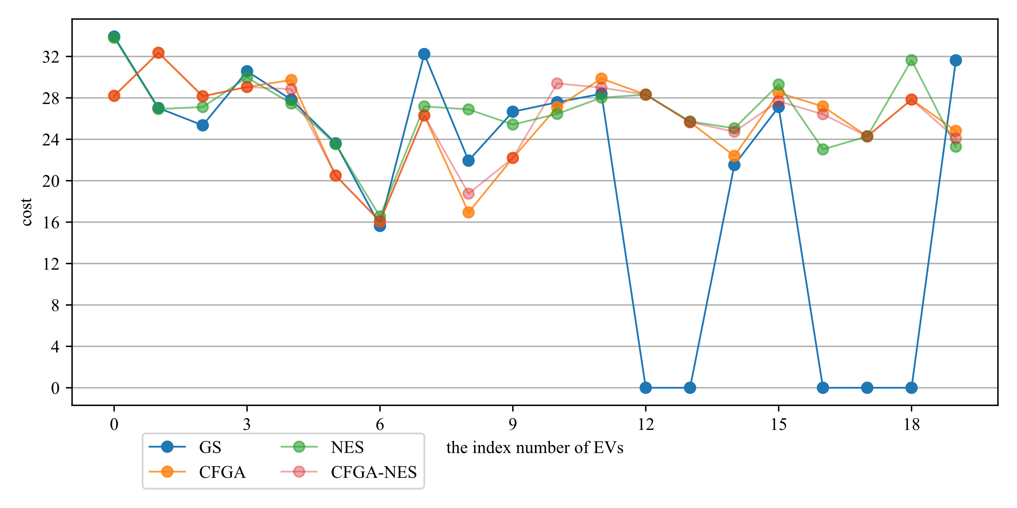
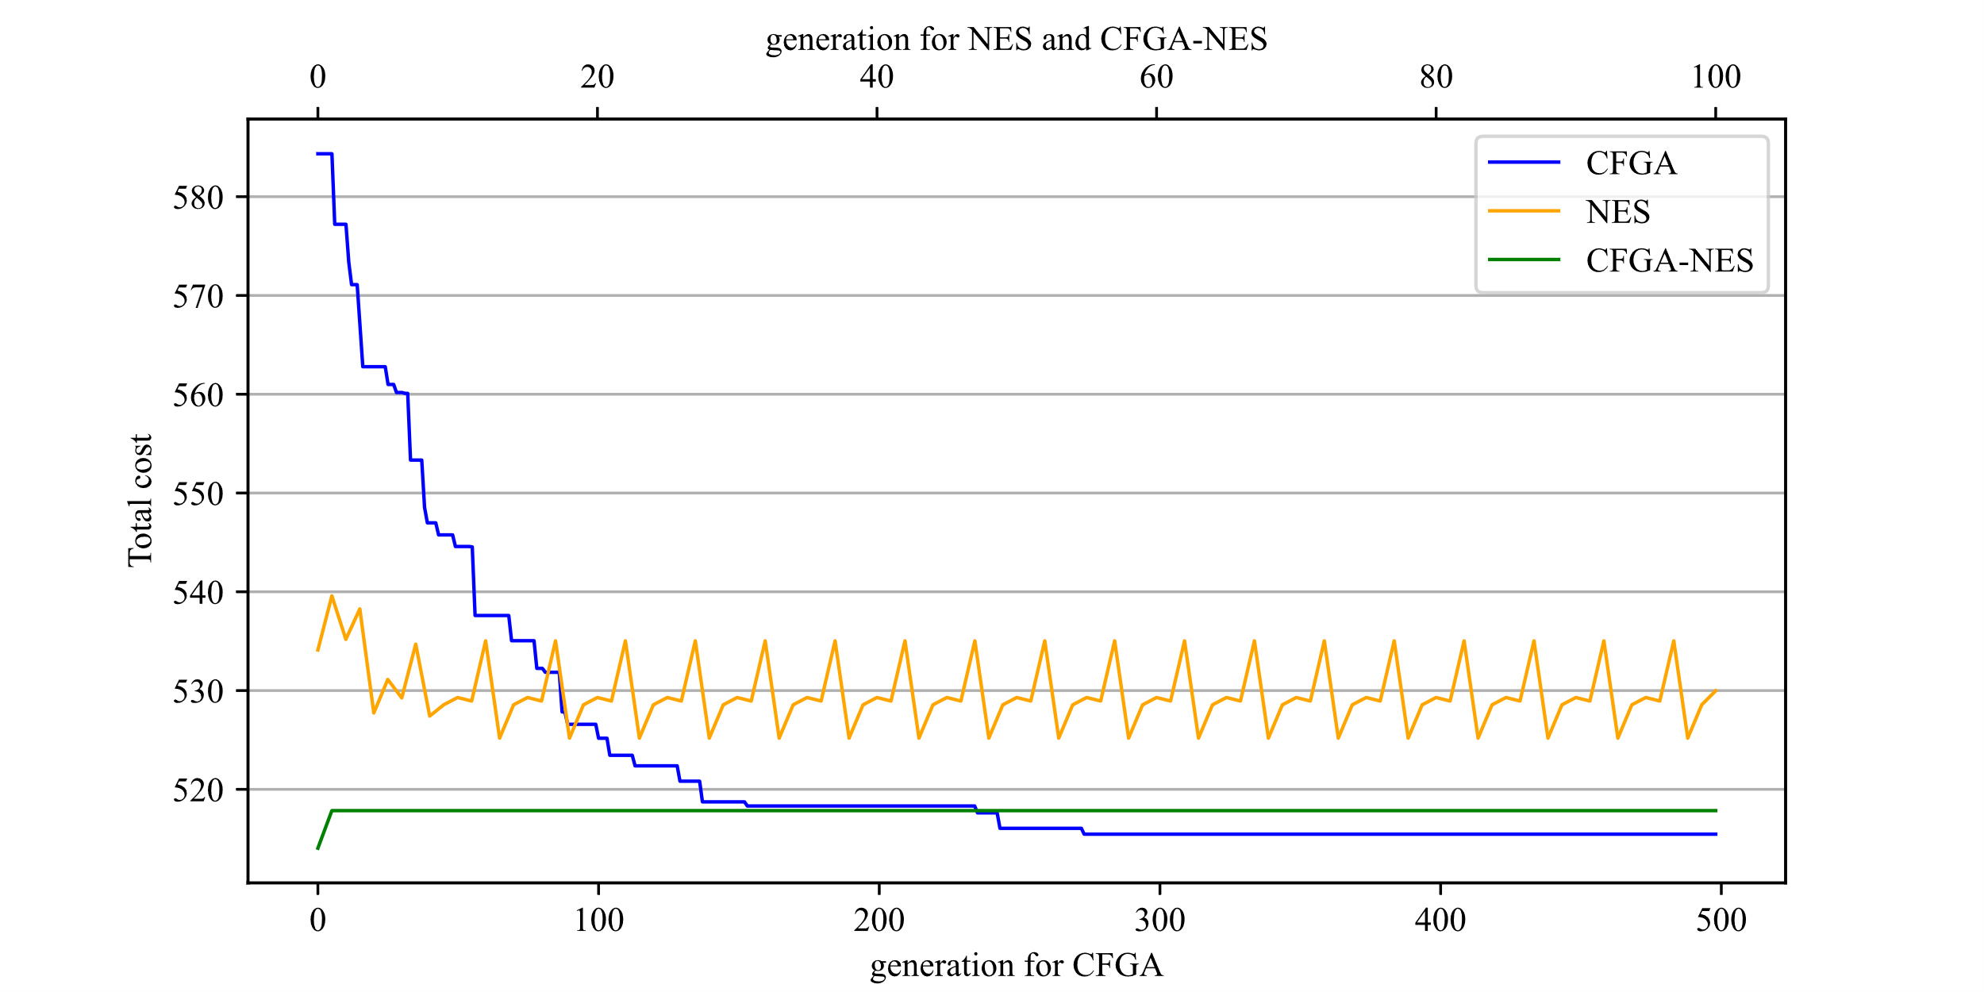
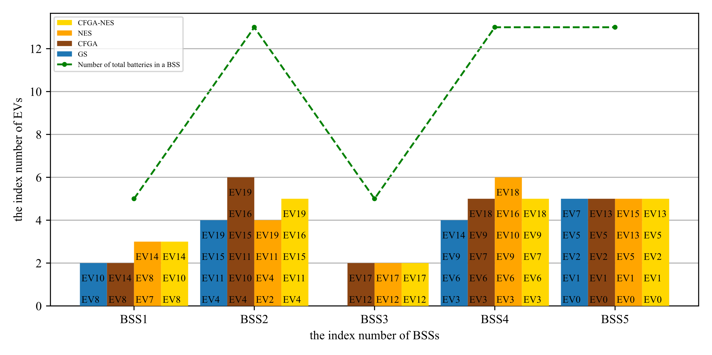
Introduction
Background
Algorithm
Experiment
Future plans
Small-Scale Case -20 EVs and 5 BSSs
Figure 7. Cost of 20 EVs by CFGA, NES and CFGA-NES under the small-scale case.
Figure 6. Trend of total cost of 20 EVs by CFGA, NES and CFGA-NES under the small-scale case
Figure 8. BSSs selection of 20 EVs by CFGA, NES and CFGA-NES under the small-scale case
15
Notes:
In the Small-Scale Case, consider an area with 5 BSSs, each equipped with a certain number of batteries. At a certain moment t, there are 20 EVs that require battery swapping. Fig. 6. illustrates the trend of the total cost of all EVs with during the iterative process for the GS, CFGA, NES, and CFGA-NES algorithms. It can be observed that when CFGA converges, the costs for each EV will remain constant, which implies the corresponding BSSs chosen by each EV will also remain unchanged. However, NES is an approximate NE seeking algorithm based on best response. Since during the iterative process, EVs can only decide their best response for this round based on the joint strategy information from the last iteration, and the change in their own strategy may affect the strategy of other EVs in the next iteration, the strategy of each EV may remain unchanged as the number of iterations increases, meaning that the joint strategy of the EVs has already reached a Nash equilibrium. But there may also be mutual interference, leading to fluctuations in the strategies of EVs. But this fluctuation is periodic, so it is also considered that the algorithm ultimately converges to a stable approximate NE. Note that in the CFGA-NES, the total cost of EVs converges quickly after only changed in the first few iterations, indicating that the optimal total cost solution obtained by CFGA is very close to the ONE solution, and sometimes it is indeed the ONE solution.

Slide 16
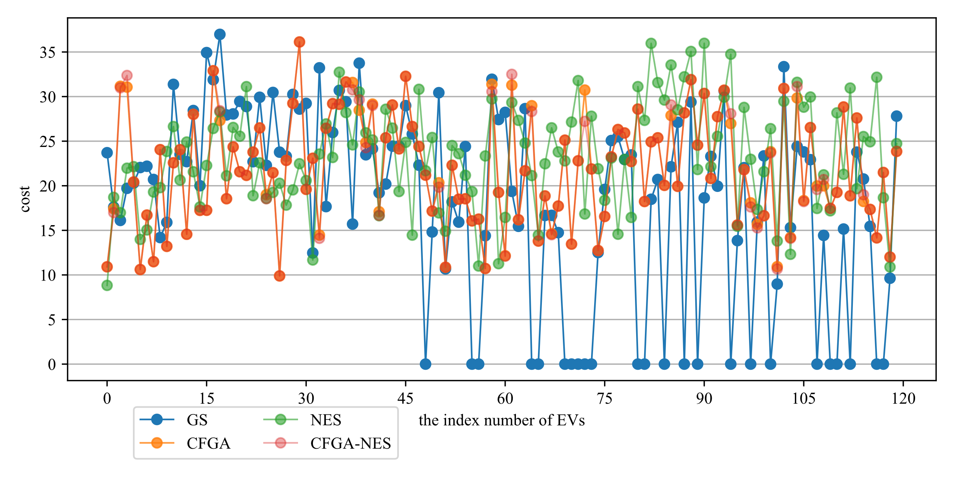
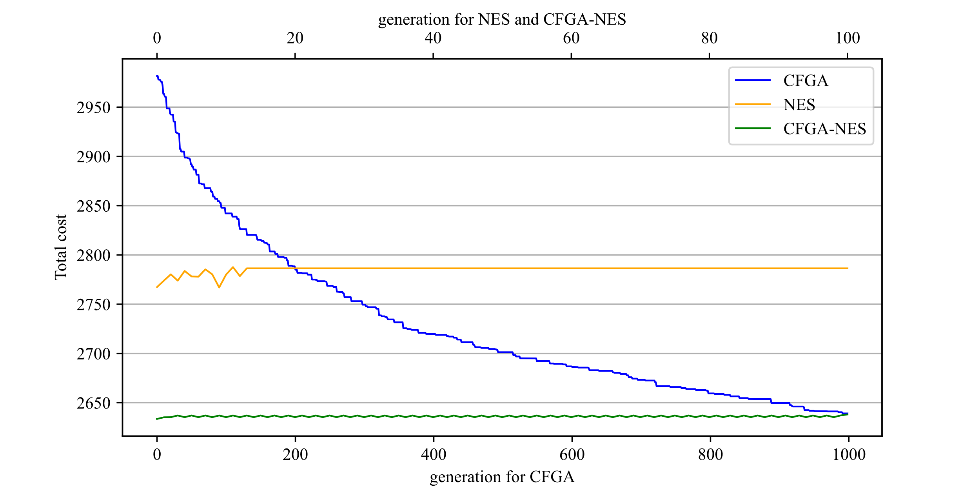
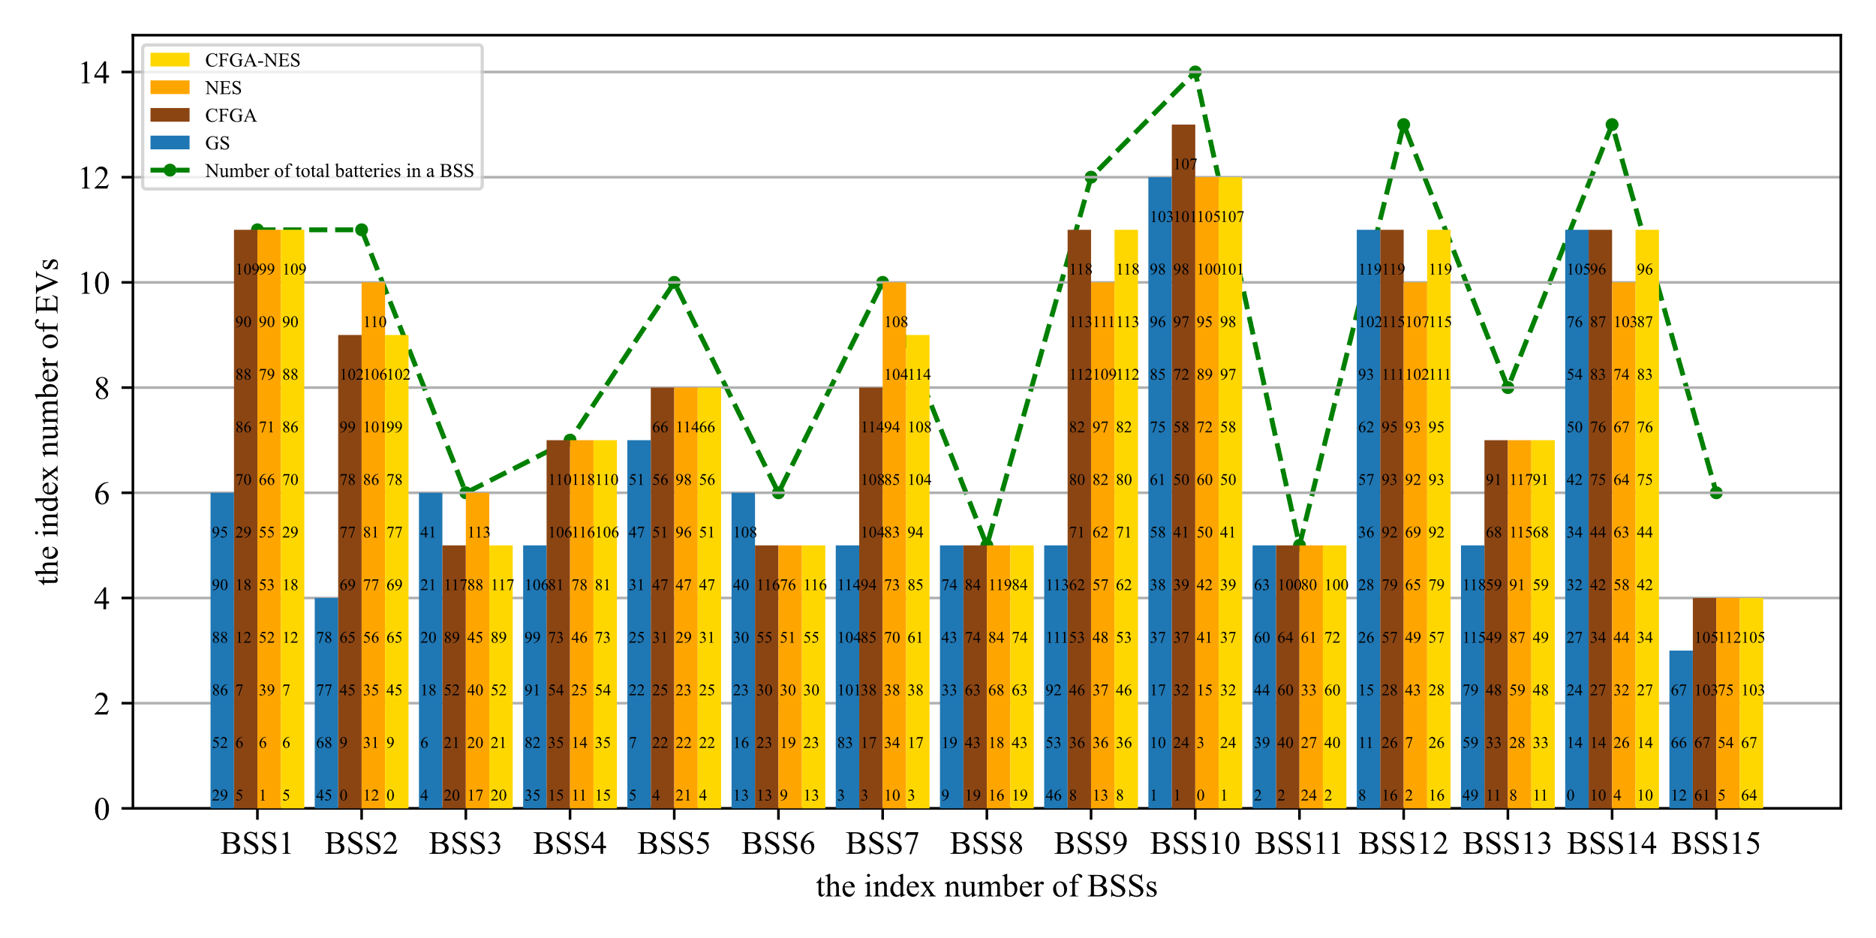
Introduction
Background
Algorithm
Experiment
Future plans
Large-Scale Case -120 EVs and 15 BSSs
Figure10. Cost of 120 EVs by CFGA, NES and CFGA-NES under the large-scale case.
Figure 9. Trend of total cost of 120 EVs by CFGA, NES and CFGA-NES under the large-scale case.
Figure 11. BSSs selection of 120 EVs by CFGA, NES and CFGA-NES under the large -scale case.
16
Notes:
In the Large-Scale Case, the trend of the total cost of all EVs with GS, CFGA, NES, and CFGA-NES are shown in Fig. 9. The curve represented by NES reveals that NES does not guarantee that the total cost of the final convergent strategy will be better than that of the initial strategy. This is because the goal of NES is to find a NE, even if the total cost of its initial strategy is better than the final strategy, the NE nature of the initial strategy cannot be guaranteed. NES will start from the initial strategy and use a smaller amplitude of change to find a NE. This is also the reason why the proposed CFGA-NES is effective. The results in Fig. 9. show that CFGA-NES is able to obtain a NE with a total cost not much different from the optimal total cost solution obtained by CFGA. Additionally, as the problem scale increases, the number of iterative rounds and the population size required by CFGA-NES also increase, which will greatly increase the time for algorithm solving. Therefore, although CFGA-NES is able to obtain the optimal NE, that is, the ONE solution, there is still room for optimization in its algorithm performance.
The best strategies of each EV obtained by CFGA, NES, and CFGA-NES under the large-scale case are shown in Fig. 11, and similar conclusions can be drawn as those in previous slide. This indicates that CFGA still maintains good performance under large-scale-case.

Slide 17
Introduction
Background
Algorithm
Experiment
Future plans
Table 5. Algorithm evaluation with two metrics
Algorithm | Mean average cost |  | Mean average BSS utilization ratio
 | Small scale | Large scale | Small scale | Large scale
GS | 26.73±0.00 | 22.79±0.00 | 28.00±0.000 | 72.76±0.00
CFGA | 25.88±0.10 | 22.03±0.05 | 41.60±1.21 | 88.26±0.33
NES | 26.99±0.43 | 23.30±0.14 | 42.59±1.67 | 88.85±0.30
CFGA-NES | 26.06±0.19 | 22.05±0.06 | 42.59±1.26 | 88.71±0.27
17
Notes:
Twenty independent repeated experiments were conducted for the two metrics for algorithm evaluation: the mean average total cost, represents the mean of the average costs calculated over each independent repeated experiments; the mean average BSS utilization ratio, represents the mean of the average BSS utilization ratio calculated over each independent repeated experiments; with the results shown in TABLE 5. It shows that GS performs the worst in both metrics. CFGA has the lowest mean average cost in both cases, and the performance of CFGA-NES is very close to CFGA. NES has the highest Mean average BSS utilization ratio in both cases, and the performance of CFGA-NES is very close to NES. The results indicate that the total cost from CFGA-NES is the optimal (guaranteed by CFGA) NE (guaranteed by NES) solution, i.e., the ONE solution.

Slide 18
Introduction
Background
Algorithm
Experiment
Future plans
Future plans
Improve algorithm accuracy
Improve the accuracy of ONE solution
Improve computing efficiency
Solve large-scale problems efficiently
Comparison of solutions
To investigate the commonality of problems that seek optimal solutions equivalent to or similar to the Nash Equilibrium
multi-scenario experiments
Attempt to conduct experiments in diversified game scenarios.
Comparative experiment
Perform a performance comparison with other algorithms
18
Notes:
We will improve the algorithm in the future as follows:
Speak according to the above

Slide 19
reference
Future plans
N. I. Nimalsiri, C. P. Mediwaththe, E. L. Ratnam, M. Shaw, D. B. Smith, and S. K. Halgamuge, “A survey of algorithms for distributed charging control of electric vehicles in smart grid,” IEEE Trans. Intell. Transp. Syst., vol. 21, no. 11, pp. 4497–4515, Nov. 2019.
Nash J. Non-Cooperative Games. The Annals of Mathematics. 1951;54.
L. Ran, Y. Wan, J. Qin, W. Fu, D. Zhang and Y. Kang, “A game-based battery swapping station recommendation approach for electric vehicles,” IEEE Trans. Intell. Transp. Syst., vol. 24, no. 9, pp. 9849 - 9860, Sep. 2023.
19

Slide 20
Thanks

